Slide 1


The Gospel of
John

Slide 2

The Gospel of
John
A Prayer for Glorification, Unification, and Sanctification
(John 17)
Notes:
The period of conference concludes with Jesus praying to the Father for the unity and sanctification of His apostles and of all believers. Their unity and sanctification would be vital to the salvation of the world. The prayers regarding relationships echo the teaching on relationships in John 15.
NOTE: John 17:6 "I have manifested Your name to the men whom You have given Me out of the world. They were Yours, You gave them to Me, and they have kept Your word.
John 17:14-17 I have given them Your word; and the world has hated them because they are not of the world, just as I am not of the world. 15 I do not pray that You should take them out of the world, but that You should keep them from the evil one. 16 They are not of the world, just as I am not of the world. 17 Sanctify them by Your truth. Your word is truth.
COMPARE: John 15:3 You are already clean because of the word which I have spoken to you.
John 15:7-8 If you abide in Me, and My words abide in you, you will ask what you desire, and it shall be done for you. 8 By this My Father is glorified, that you bear much fruit; so you will be My disciples.
John 15:18-19 "If the world hates you, you know that it hated Me before it hated you. 19 If you were of the world, the world would love its own. Yet because you are not of the world, but I chose you out of the world, therefore the world hates you.

Slide 3
A Prayer for Glorification, Sanctification, and Unification (John 17)
  OVERVIEW:
  Jesus offers a prayer of intercession* for the apostles and all believers (cf. 1 Timothy 2:1).
    Jesus prays that His glory, which He shares with the apostles, would redound to the glory of the Father (17:4-5, 10, 22-24).
    Jesus prays for the continued sanctification of the apostles (17:6, 15-17).
    Jesus prays for unity among the apostles and all believers (17:20-23).
Notes:
Having spent so much time conferring with the apostles in preparation for His departure, Jesus ends with an intercessory prayer for their glorification, unification and sanctification.
1 Timothy 2:1 Therefore I exhort first of all that supplications, prayers, intercessions, and giving of thanks be made for all men,
Jesus spoke these words, lifted up His eyes to heaven, and said: "Father, the hour has come. Glorify Your Son, that Your Son also may glorify You,
Joh_17:4 I have glorified You on the earth. I have finished the work which You have given Me to do.
Joh_17:5 And now, O Father, glorify Me together with Yourself, with the glory which I had with You before the world was.
Joh_17:10 And all Mine are Yours, and Yours are Mine, and I am glorified in them.
Joh_17:22 And the glory which You gave Me I have given them, that they may be one just as We are one:
Joh_17:24 "Father, I desire that they also whom You gave Me may be with Me where I am, that they may behold My glory which You have given Me; for You loved Me before the foundation of the world.

Slide 4
A Prayer for Glorification, Sanctification, and Unification (John 17)
  Jesus prays for glory for Himself and the Father as He completes the work of eternal redemption (17:1-5).
    Jesus prays to be glorified, so that the Father may be glorified in Him (17:1).
    He has been given “all authority” for the purpose of being able to give eternal life (17:2; John 5:26-27).
    Eternal life is knowing God the Father through His Son (17:3; 1 John 5:20).
    The Son has glorified the Father by finishing the work the Father had given Him to do (17:4; Phil 2:2-11).
      Jesus now requests to be restored to the glory He had before the world began (17:5).
Notes:
John 5:26-27 For as the Father has life in Himself, so He has granted the Son to have life in Himself, 27 and has given Him authority to execute judgment also, because He is the Son of Man.
1 John 5:20 And we know that the Son of God has come and has given us an understanding, that we may know Him who is true; and we are in Him who is true, in His Son Jesus Christ. This is the true God and eternal life.

Slide 5
A Prayer for Glorification, Sanctification, and Unification (John 17)
  Jesus prays for the apostles (17:6-19).
    Jesus had shown the Father to these men (17:6-9).
      They belonged to the Father, and they kept His word.
      They knew the Ultimate Source of the words Jesus had given them.
    Jesus prays for them as gifts from God, belonging to Himself and the Father, who glorify Jesus (17:9b-10).
    Jesus prays that God will “keep” them as they fulfill their mission in the world (17:11-13).
      Their unity must not be disrupted.
      Jesus had kept all but one of them “that the Scripture might be fulfilled” (John 13:18; Psalm 41:9).
      The words Jesus prays are designed to leave joy with the apostles even as He departs to the Father (John 15:11).
Notes:
John 13:18 "I do not speak concerning all of you. I know whom I have chosen; but that the Scripture may be fulfilled, 'HE WHO EATS BREAD WITH ME HAS LIFTED UP HIS HEEL AGAINST ME.’ (CF. Psalm 41:9).
John 15:11 "These things I have spoken to you, that My joy may remain in you, and that your joy may be full.

Slide 6
A Prayer for Glorification, Sanctification, and Unification (John 17)
  Jesus prays for the apostles (17:6-19).
    Jesus prays that they will be sanctified and protected through the word they are taking to a hostile world (7:14-17).
      They are not of the world and need to be protected.
      Jesus is sending them into the world, just as the Father sent Him into the world.
      Jesus consecrated Himself wholly to God’s truth so that the apostles could and would do so also.
Notes:
Sent is from “apostello”

Slide 7
A Prayer for Glorification, Sanctification, and Unification (John 17)
  Jesus prays for all believers (17:20-26).
    Jesus prays for the unity of those who would believe through the words of the apostles (17:20).
    Their unity would enable the world to believe, and they would be one as they share in His glory (17:21-23).
    Jesus prays that those whom God gives Him will be with Him in glory (17:24a; 2 Thess. 1:10; Rev. 3:21).
    Jesus prays that God’s eternal love for Him would be experienced by those who follow Him (17:24b-26; 1 John 3:1).
Notes:
2 Thessalonians 1:10 when He comes, in that Day, to be glorified in His saints and to be admired among all those who believe, because our testimony among you was believed.
Revelation 3:21 To him who overcomes I will grant to sit with Me on My throne, as I also overcame and sat down with My Father on His throne.
1 John 3:1 Behold what manner of love the Father has bestowed on us, that we should be called children of God! Therefore the world does not know us, because it did not know Him.

Slide 8
Assignment
  Read John 18 before Sunday’s class.

Slide 9
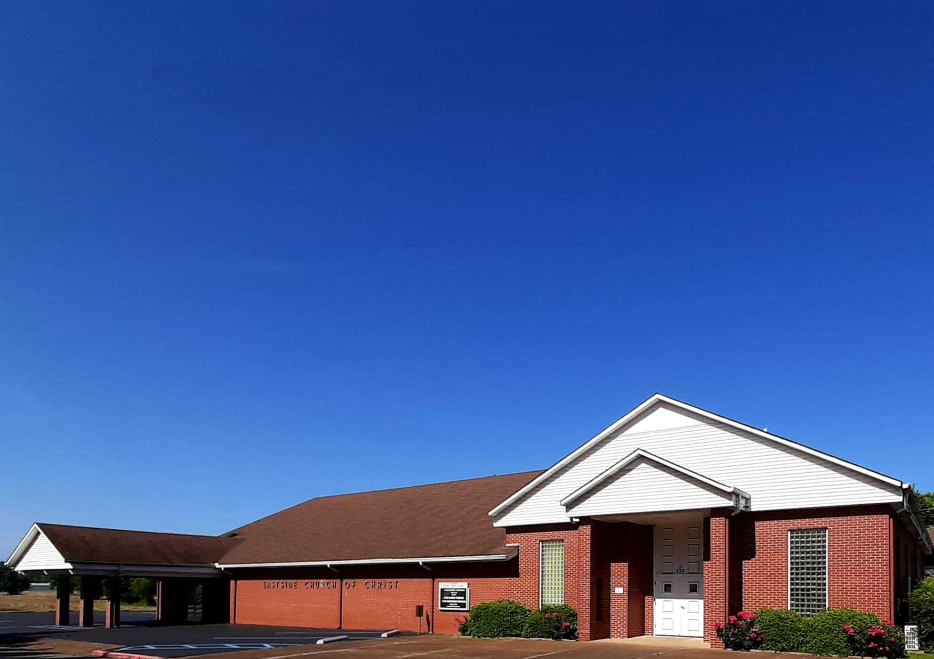
Eastside Church of Christ
Eastside-church.org

